Slide 1
Video Game Narrative
History, Genre, and Technique

Slide 2
The History of Video Game Storytelling

Slide 3
Early Storytelling in Games
Choose-Your-Own-Adventure books, text based adventures of the 80s
Zork I: The Great Underground Empire (1980)
First voice synthesis: Space Spartans (1981)
First cutscene: Maniac Mansion (1987)
Story as context (think Zelda or Space Invaders)
Motion capture: Prince of Persia (1989)

Slide 4
Storytelling Genres in Gaming
Linear (“on-the-rails”)
Sandbox
Conceptual/abstract
Choose-Your-Own-Adventure (Telltale style)
Open World
RPGs
Any mix of these together
And these are just a few...

Slide 5
Gameplay is King

Slide 6
“It’s only when a game manages to miraculously rise above this low quality bar and present plot, character, and dialogue on par with, say, a direct-to-disc movie that reviewers and players might sit up and take notice.”
Evan Skolnik
Video Game Storytelling
Pages 101-102
2014

Slide 7
From Games as Context to Games as Art
More thematically mature and complex stories
Story is given greater stake in production
Now we not only have video games strictly as game, but games as experience

Slide 8
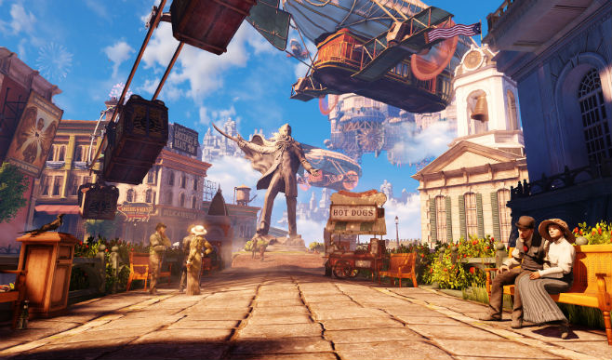

Slide 9
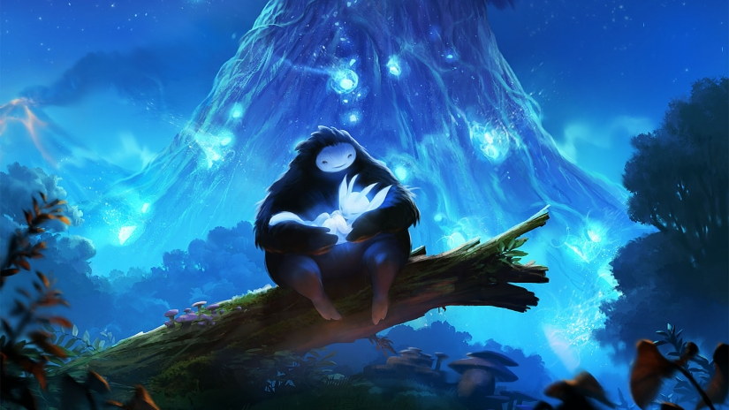

Slide 10
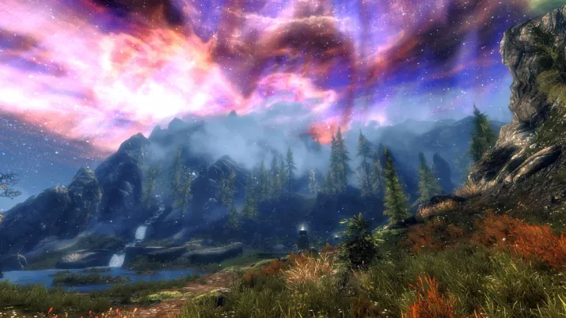

Slide 11
Storytelling Techniques Borrowed From Other Media
Cinematography (cutscenes)
Live motion games
Literary and historical themes (Ayn Rand, The Road, Tolkien)
Screenwriting
Motion capture
Music

Slide 12
Storytelling Techniques in Gaming
Manuals
Lore
Cutscenes
Story in pickups (audio diaries, journal entries, artifacts, etc.)
Environmental storytelling
Story through gameplay (this is the big one, more on this in a second)
Art/Stills

Slide 13
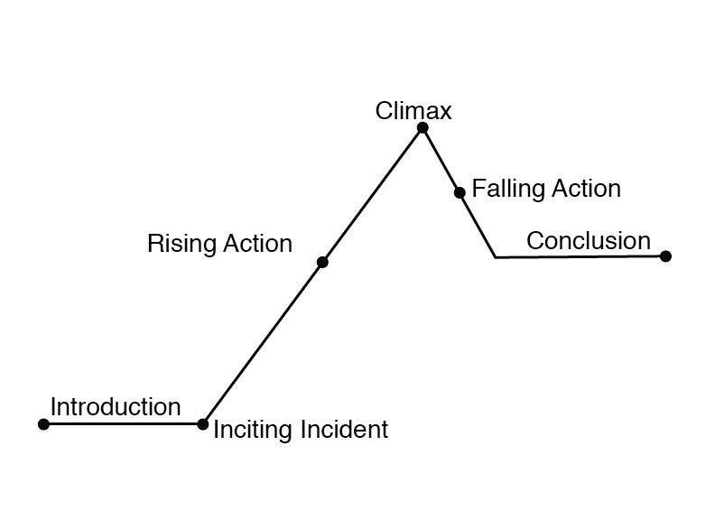

Slide 14
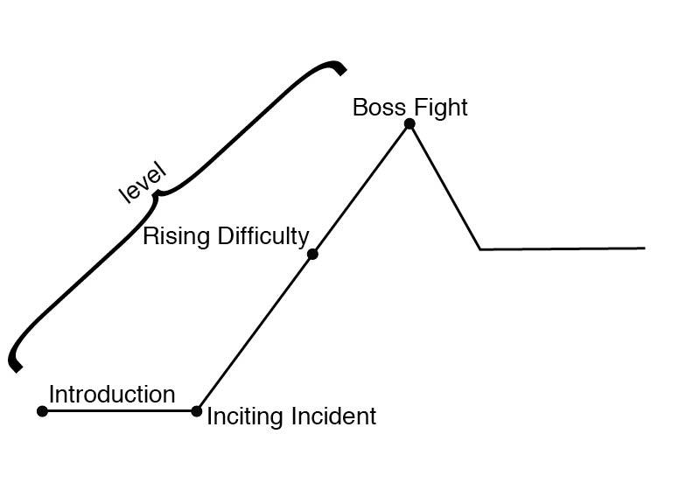

Slide 15
What is metanarrative?

Slide 16
Florence (2018)

Slide 17
Ludonarrative Dissonance/Harmony
One of the earliest schools of narrative game theory
Introduced and coined by game designer Clint Hocking in a 2007 blog post titled “Ludonarrative Dissonance in Bioshock: the problem of what the game is about”
The ideals of the game’s story/theme don’t match up with what’s best for the player

Slide 18
Other Schools of Thought
Ludology vs. Narratology
Game theory (a mathematical approach to games)
We can also apply literary/film theory (feminist/gender theory, color theory, marxism, post-modernism, constructivism, psychoanalysis, etc.)

Slide 19
Does better tech = better storytelling?

Slide 20
Why do you like/want storytelling in games?

